Slide 1
Effect of pulmonary opportunistic infections on long-term pulmonary function in PLWH who smoke
Khai Hoan Tram, Jane O’Halloran, Rachel Presti, Jeffrey Atkinson
Department of Medicine
Division of Infectious Diseases & Division of Pulmonary and Critical Care Medicine

Slide 2
Disclosures
None

Slide 3
Background
Pulmonary complications remain a significant source of morbidity and mortality in people living with HIV.¹
The prevalence of smoking in PLWH is 2-3 times greater than in those not living with HIV. Outpatient smoking prevalence among PLWH range from 39-59%.²
As PLWH are living longer, high smoking rates contribute to increasing incidence of COPD. PLWH have higher rates of dyspnea, alterations in pulmonary function tests (PFTs), and reported respiratory symptoms.³
¹ Rothenberg 1987, Grubb 2006, Fitzpatrick 2016, Crothers 2011
² Shirley 2013, Drummond 2012, Ho 2012, Tesoriero 2010, Mamary 2002, Kirk 2011
³ Crothers 2011, George 2009, Campo 2014

Slide 4
Objective
We aimed to examine the long-term sequelae of pulmonary opportunistic infections (OIs) in PLWH who smoke.

Slide 5
Methods
Study Population
Single site in the Investigating HIV-Associated Lung Disease (INHALD) network.
Inclusion criteria:
PLWH
30-75 years of age
At least 15 pack-year smoking history or current smoker
Exclusion criteria:
Recent illness
Malignancy
Lung disease other than emphysema
Lung surgery
Pregnancy

Slide 6
Methods
Data Collection
Health questionnaire
Demographics, smoking history, HIV status (diagnosis, CD4 count, therapy)
History of pulmonary opportunistic infections (PCP, tuberculosis, recurrent bacterial infections)
Respiratory symptoms and function
St. George’s Respiratory Questionnaire (SGRQ): symptoms, activities, and impact
Pulmonary function tests (PFTs)
FEV1, FVC, FEV1/FVC, DLCO
Data Analysis
We used chi-square, two-sample t-test, and logistic regression to compare PLWH with and without a history of pulmonary Opportunistic Infections (OI’s).

Slide 7
Results
153 PLWH who were current smokers or had a 15 pack year history of smoking were recruited between 3/2014 – 4/2018.
100% completion rate for the health questionnaire & SGRQ
134/153 (86%) completed pulmonary function testing (PFT)
37/153 (24%) had a history of pulmonary OI’s:
Pneumocystis pneumonia, 25 (16%)
Recurrent bacterial pneumonia, 12 (7.8%)
Pulmonary tuberculosis, 7 (4.6%)

Slide 8
Results
Characteristics of patients with and without a history of Pulmonary Opportunistic Infections
 | History of Pulmonary OI (n = 37) |  | No history of Pulmonary OI (n = 116) |  | p-value
Age, median (IQR) | 54 | (49-57) | 49 | (44-54) | 0.001
Female, n(%) | 10 | (24%) | 28 | (27%) | 0.723
African American, n(%) | 28 | (90%) | 75 | (73%) | 0.125
Education, 12th grade or higher n(%) | 27 | (73%) | 87 | (76%) | 0.681
Income, <$30,000/year n(%) | 30 | (81%) | 101 | (89%) | 0.188
Years since HIV diagnosis, median (IQR) | 17 | (11-23) | 16 | (8-22) | 0.322
Current CD4+, median (IQR) | 452 | (263-755) | 632 | (446-834) | 0.009
Nadir CD4+, median (IQR) | 57 | (13-141) | 187 | (95-304) | <0.001
On HAART, n(%) | 37 | (100%) | 114 | (98%) | 0.421
Undetectable viral load, n(%) | 29 | (81%) | 92 | (84%) | 0.590

Slide 9
Results
Characteristics of patients with and without a history of Pulmonary Opportunistic Infections
 | History of Pulmonary OI (n = 37) |  | No history of Pulmonary OI (n = 116) |  | p-value
Age, median (IQR) | 54 | (49-57) | 49 | (44-54) | 0.001
Female, n(%) | 10 | (24%) | 28 | (27%) | 0.723
African American, n(%) | 28 | (90%) | 75 | (73%) | 0.125
Education, 12th grade or higher n(%) | 27 | (73%) | 87 | (76%) | 0.681
Income, <$30,000/year n(%) | 30 | (81%) | 101 | (89%) | 0.188
Years since HIV diagnosis, median (IQR) | 17 | (11-23) | 16 | (8-22) | 0.322
Current CD4+, median (IQR) | 452 | (263-755) | 632 | (446-834) | 0.009
Nadir CD4+, median (IQR) | 57 | (13-141) | 187 | (95-304) | <0.001
On HAART, n(%) | 37 | (100%) | 114 | (98%) | 0.421
Undetectable viral load, n(%) | 29 | (81%) | 92 | (84%) | 0.590

Slide 10
Results
Characteristics of patients with and without a history of Pulmonary Opportunistic Infections
 | History of Pulmonary OI (n = 37) |  | No history of Pulmonary OI (n = 116) |  | p-value
Age, median (IQR) | 54 | (49-57) | 49 | (44-54) | 0.001
Female, n(%) | 10 | (24%) | 28 | (27%) | 0.723
African American, n(%) | 28 | (90%) | 75 | (73%) | 0.125
Education, 12th grade or higher n(%) | 27 | (73%) | 87 | (76%) | 0.681
Income, <$30,000/year n(%) | 30 | (81%) | 101 | (89%) | 0.188
Years since HIV diagnosis, median (IQR) | 17 | (11-23) | 16 | (8-22) | 0.322
Current CD4+, median (IQR) | 452 | (263-755) | 632 | (446-834) | 0.009
Nadir CD4+, median (IQR) | 57 | (13-141) | 187 | (95-304) | <0.001
On HAART, n(%) | 37 | (100%) | 114 | (98%) | 0.421
Undetectable viral load, n(%) | 29 | (81%) | 92 | (84%) | 0.590

Slide 11
Results
Characteristics of patients with and without a history of Pulmonary Opportunistic Infections
 | History of Pulmonary OI (n = 37) |  | No history of Pulmonary OI (n = 116) |  | p-value
Age, median (IQR) | 54 | (49-57) | 49 | (44-54) | 0.001
Female, n(%) | 10 | (24%) | 28 | (27%) | 0.723
African American, n(%) | 28 | (90%) | 75 | (73%) | 0.125
Education, 12th grade or higher n(%) | 27 | (73%) | 87 | (76%) | 0.681
Income, <$30,000/year n(%) | 30 | (81%) | 101 | (89%) | 0.188
Years since HIV diagnosis, median (IQR) | 17 | (11-23) | 16 | (8-22) | 0.322
Current CD4+, median (IQR) | 452 | (263-755) | 632 | (446-834) | 0.009
Nadir CD4+, median (IQR) | 57 | (13-141) | 187 | (95-304) | <0.001
On HAART, n(%) | 37 | (100%) | 114 | (98%) | 0.421
Undetectable viral load, n(%) | 29 | (81%) | 92 | (84%) | 0.590

Slide 12
Results
Characteristics of patients with and without a history of Pulmonary Opportunistic Infections (cont.)
 | History of Pulmonary OI (n = 37) | No history of Pulmonary OI (n = 116) | p-value
Current smoker, n(%) | 28 (76%) | 96 (84%) | 0.239
Current daily cigarettes, median (IQR) | 10 (10-20) | 10 (6-20) | 0.596
Age started smoking, median (IQR) | 16 (14-21) | 16 (13-19) | 0.791
Pack-year history, median (IQR) | 20.5 (13.2-37) | 23.6 (12.9-36) | 0.690
History of chronic breathing problems, n(%) | 13 (35%) | 20 (18%) | 0.028
Medical treatments (in the past year), n(%)
Steroids | 6 (16%) | 6 (5.2%) | 0.030
Antibiotics | 5 (14%) | 4 (3.5%) | 0.023
Emergency room visit | 3 (8.1%) | 4 (3.5%) | 0.238
Hospitalization | 3 (8.1%) | 2 (1.7%) | 0.057
Home oxygen treatment | 0 (0%) | 1 (0.9%) | 0.571

Slide 13
Results
Characteristics of patients with and without a history of Pulmonary Opportunistic Infections (cont.)
 | History of Pulmonary OI (n = 37) | No history of Pulmonary OI (n = 116) | p-value
Current smoker, n(%) | 28 (76%) | 96 (84%) | 0.239
Current daily cigarettes, median (IQR) | 10 (10-20) | 10 (6-20) | 0.596
Age started smoking, median (IQR) | 16 (14-21) | 16 (13-19) | 0.791
Pack-year history, median (IQR) | 20.5 (13.2-37) | 23.6 (12.9-36) | 0.690
History of chronic breathing problems, n(%) | 13 (35%) | 20 (18%) | 0.028
Medical treatments (in the past year), n(%)
Steroids | 6 (16%) | 6 (5.2%) | 0.030
Antibiotics | 5 (14%) | 4 (3.5%) | 0.023
Emergency room visit | 3 (8.1%) | 4 (3.5%) | 0.238
Hospitalization | 3 (8.1%) | 2 (1.7%) | 0.057
Home oxygen treatment | 0 (0%) | 1 (0.9%) | 0.571

Slide 14
Results
Characteristics of patients with and without a history of Pulmonary Opportunistic Infections (cont.)
 | History of Pulmonary OI (n = 37) | No history of Pulmonary OI (n = 116) | p-value
Current smoker, n(%) | 28 (76%) | 96 (84%) | 0.239
Current daily cigarettes, median (IQR) | 10 (10-20) | 10 (6-20) | 0.596
Age started smoking, median (IQR) | 16 (14-21) | 16 (13-19) | 0.791
Pack-year history, median (IQR) | 20.5 (13.2-37) | 23.6 (12.9-36) | 0.690
History of chronic breathing problems, n(%) | 13 (35%) | 20 (18%) | 0.028
Medical treatments (in the past year), n(%)
Steroids | 6 (16%) | 6 (5.2%) | 0.030
Antibiotics | 5 (14%) | 4 (3.5%) | 0.023
Emergency room visit | 3 (8.1%) | 4 (3.5%) | 0.238
Hospitalization | 3 (8.1%) | 2 (1.7%) | 0.057
Home oxygen treatment | 0 (0%) | 1 (0.9%) | 0.571

Slide 15
Results
Characteristics of patients with and without a history of Pulmonary Opportunistic Infections (cont.)
 | History of Pulmonary OI (n = 37) | No history of Pulmonary OI (n = 116) | p-value
Current smoker, n(%) | 28 (76%) | 96 (84%) | 0.239
Current daily cigarettes, median (IQR) | 10 (10-20) | 10 (6-20) | 0.596
Age started smoking, median (IQR) | 16 (14-21) | 16 (13-19) | 0.791
Pack-year history, median (IQR) | 20.5 (13.2-37) | 23.6 (12.9-36) | 0.690
History of chronic breathing problems, n(%) | 13 (35%) | 20 (18%) | 0.028
Medical treatments (in the past year), n(%)
Steroids | 6 (16%) | 6 (5.2%) | 0.030
Antibiotics | 5 (14%) | 4 (3.5%) | 0.023
Emergency room visit | 3 (8.1%) | 4 (3.5%) | 0.238
Hospitalization | 3 (8.1%) | 2 (1.7%) | 0.057
Home oxygen treatment | 0 (0%) | 1 (0.9%) | 0.571

Slide 16
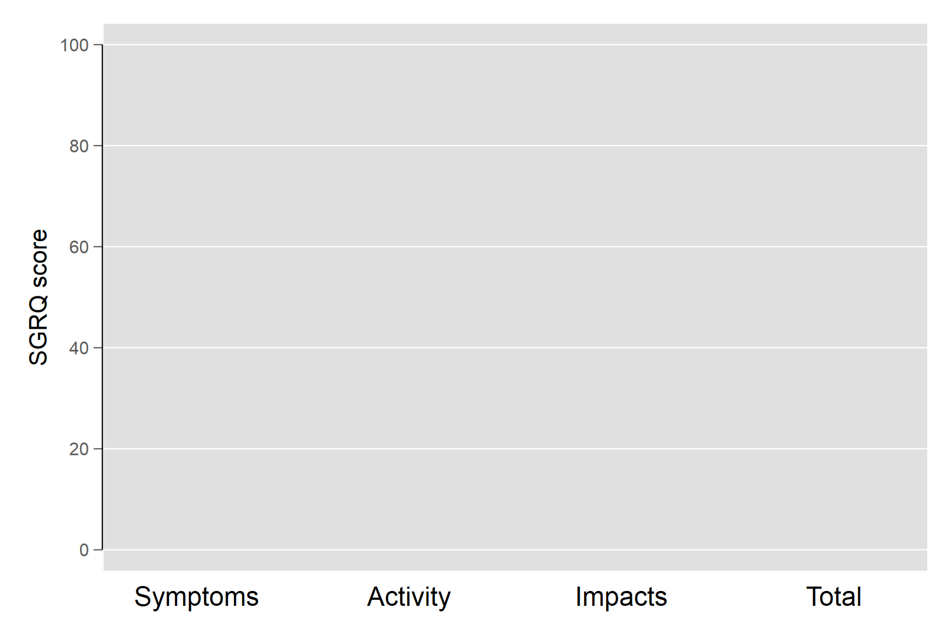
Respiratory symptoms, activity, and impacts survey (SGRQ)
Scores are expressed as a percentage of overall impairment where 100 represents worst possible health status and 0 indicates best possible health status.

Slide 17
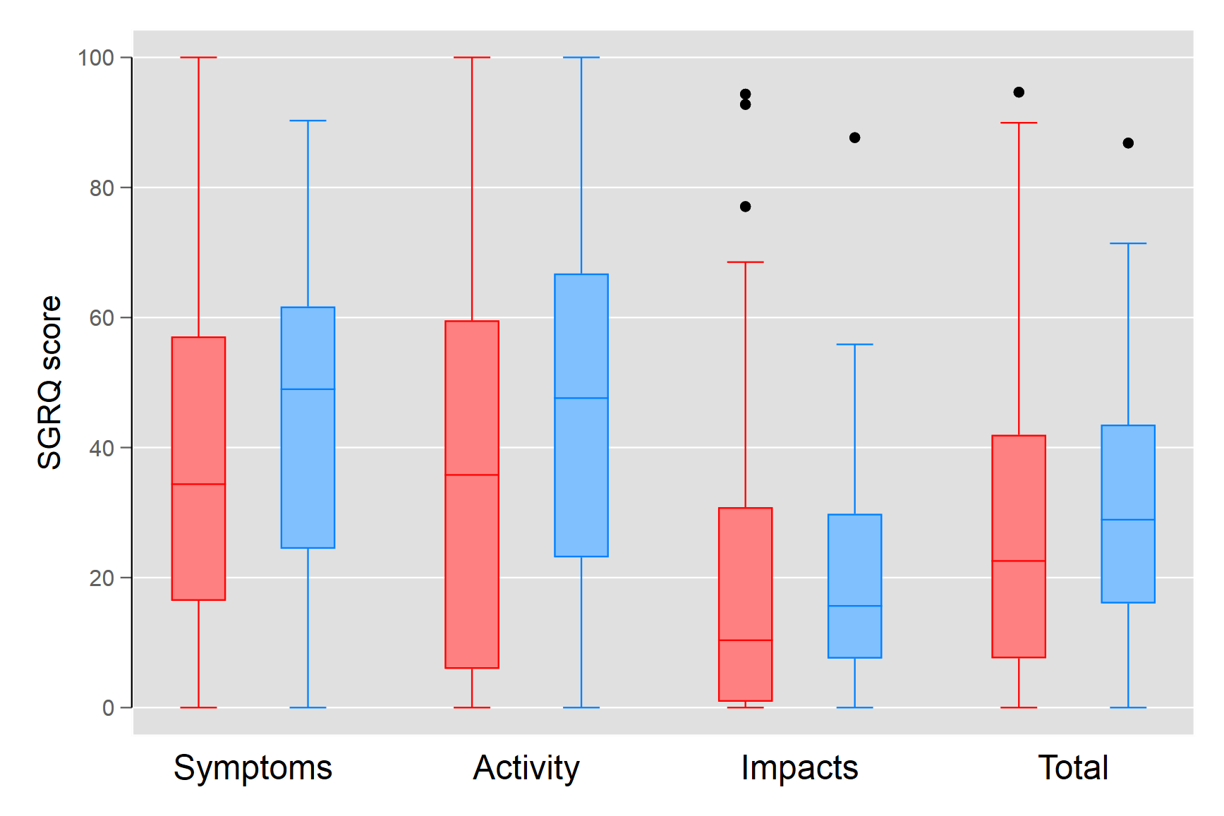
Respiratory symptoms, activity, and impacts survey (SGRQ)
RED – no history of pulmonary OI
BLUE – history of pulmonary OI
Scores are expressed as a percentage of overall impairment where 100 represents worst possible health status and 0 indicates best possible health status.

Slide 18
Respiratory symptoms, activity, and impacts survey (SGRQ)
RED – no history of pulmonary OI
BLUE – history of pulmonary OI
p = 0.153
p = 0.065
p = 0.148
Scores are expressed as a percentage of overall impairment where 100 represents worst possible health status and 0 indicates best possible health status.
p = 0.433

Slide 19
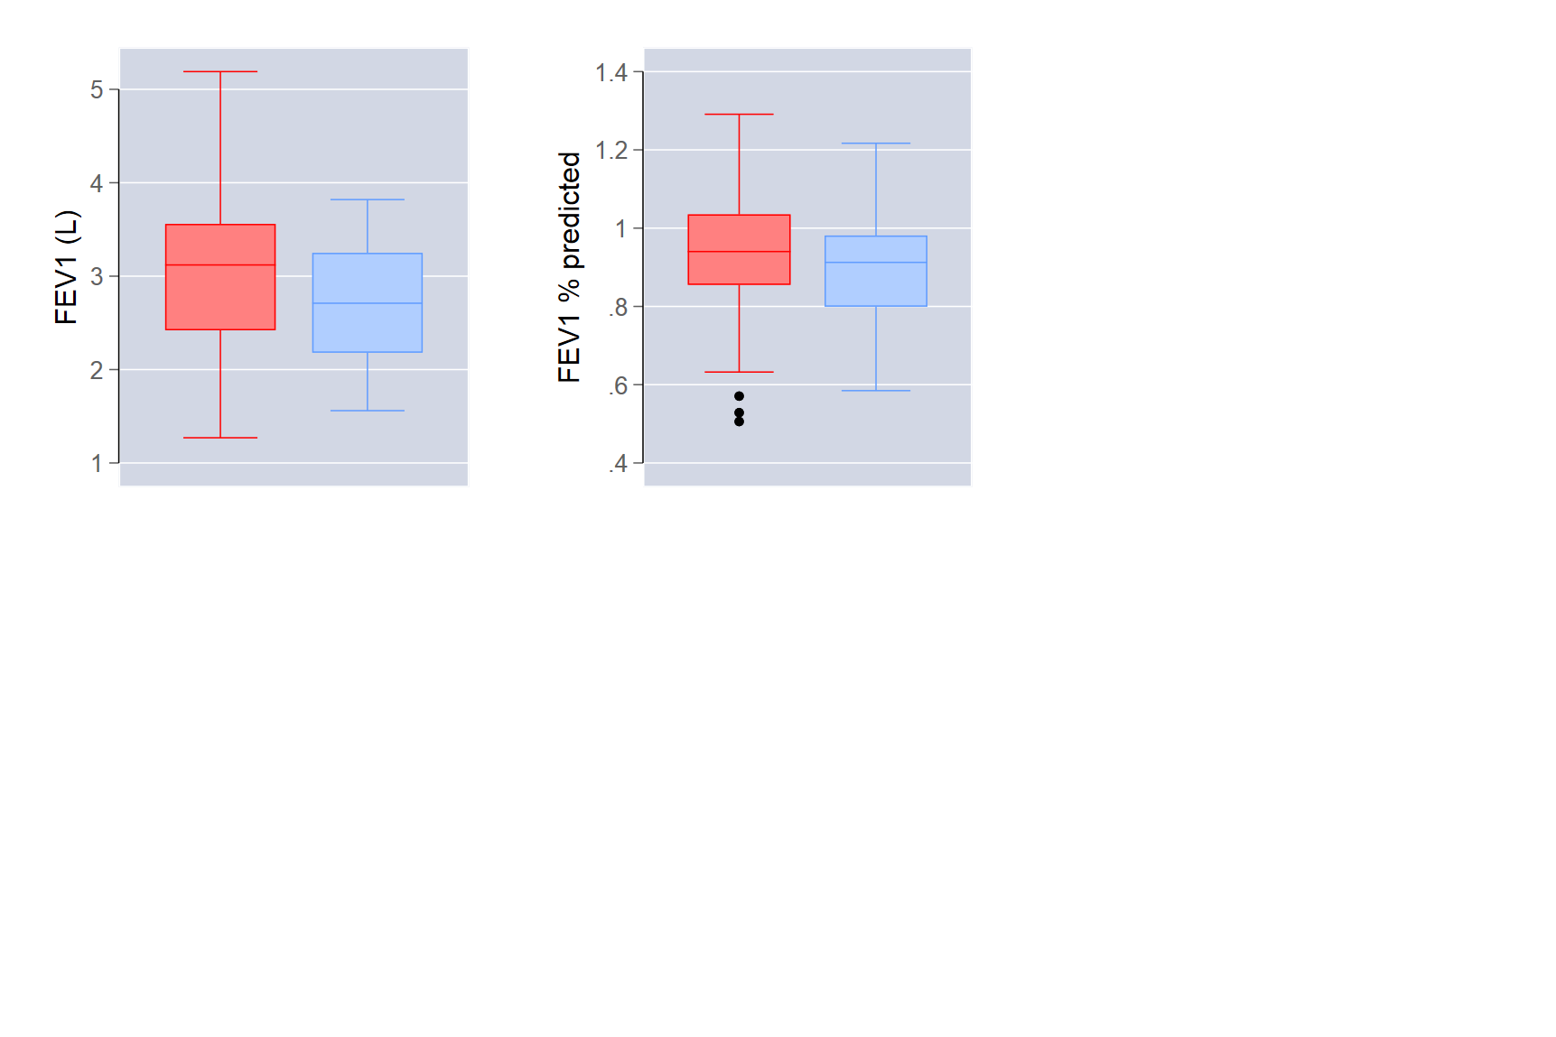
Pulmonary Function Tests
RED – no history of pulmonary OI
BLUE – history of pulmonary OI
3.1
0.94
0.90
2.7
p = 0.024
p = 0.174

Slide 20
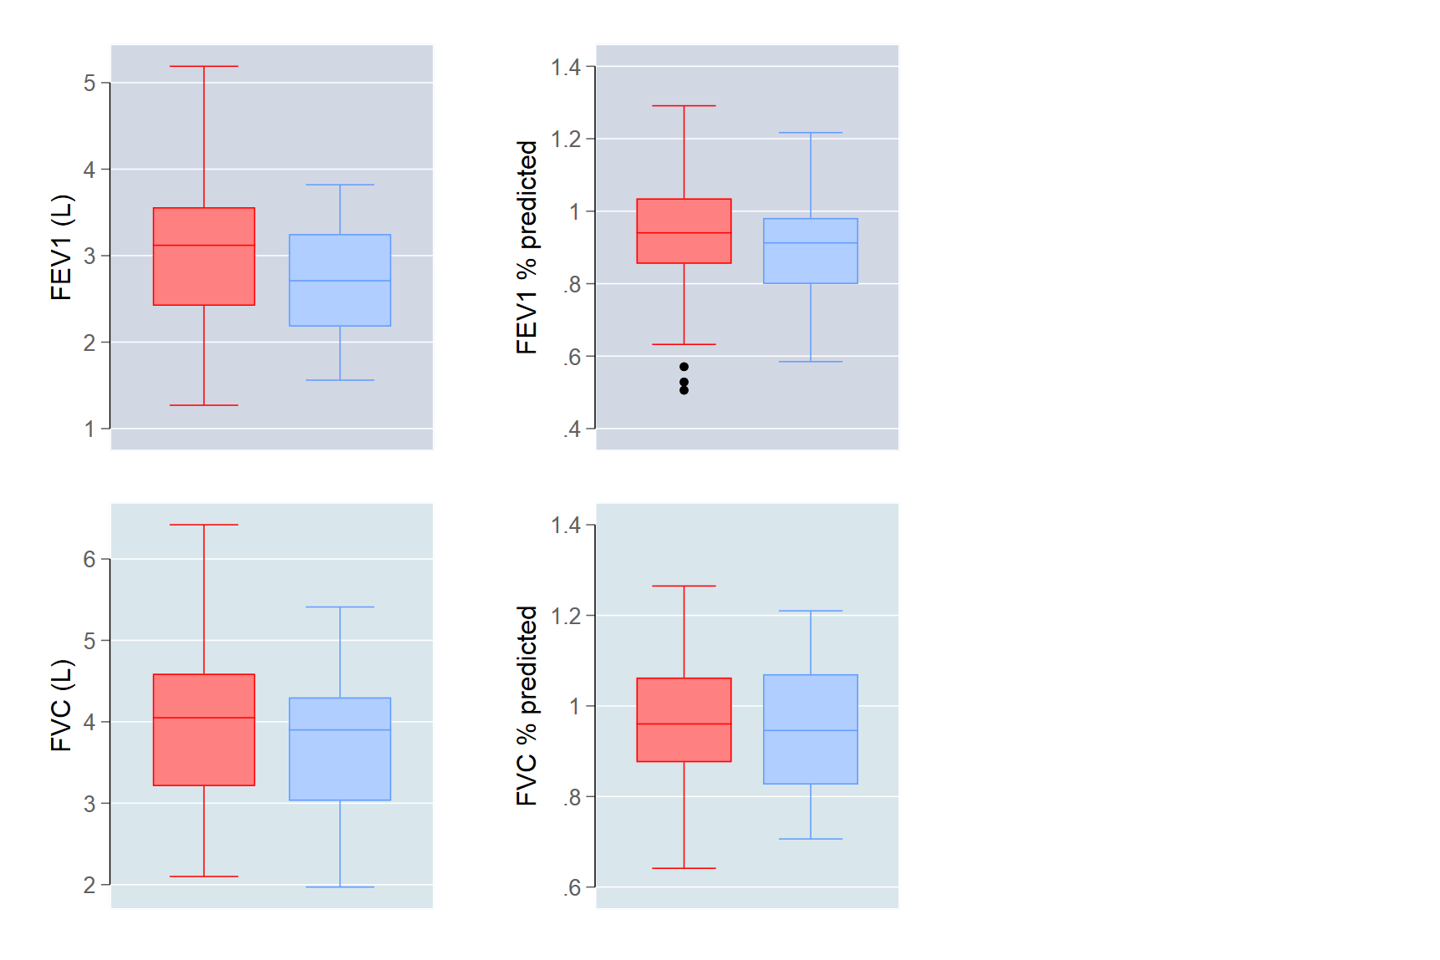
Pulmonary Function Tests
RED – no history of pulmonary OI
BLUE – history of pulmonary OI
3.1
0.94
0.90
2.7
p = 0.024
p = 0.174
4.0
3.7
0.97
0.96
p = 0.155
p = 0.679

Slide 21
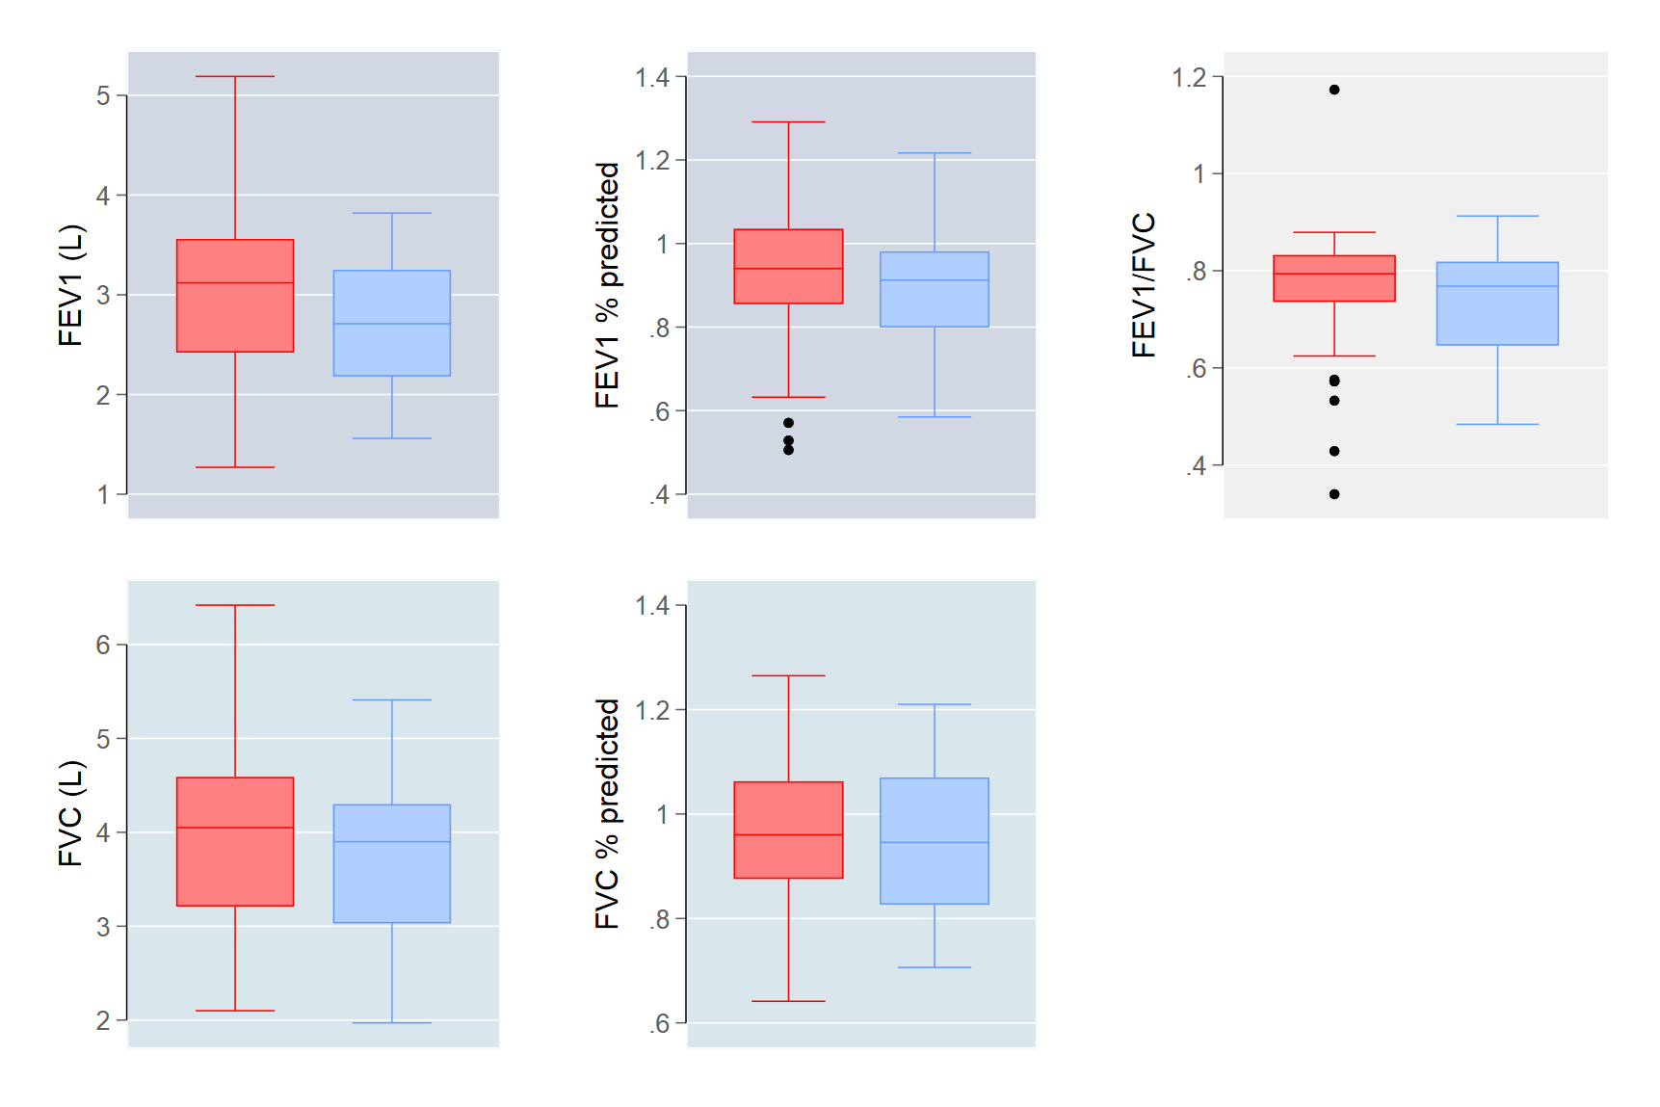
Pulmonary Function Tests
RED – no history of pulmonary OI
BLUE – history of pulmonary OI
3.1
0.94
0.90
0.77
2.7
0.75
p = 0.024
p = 0.174
p = 0.163
4.0
3.7
0.97
0.96
p = 0.155
p = 0.679

Slide 22
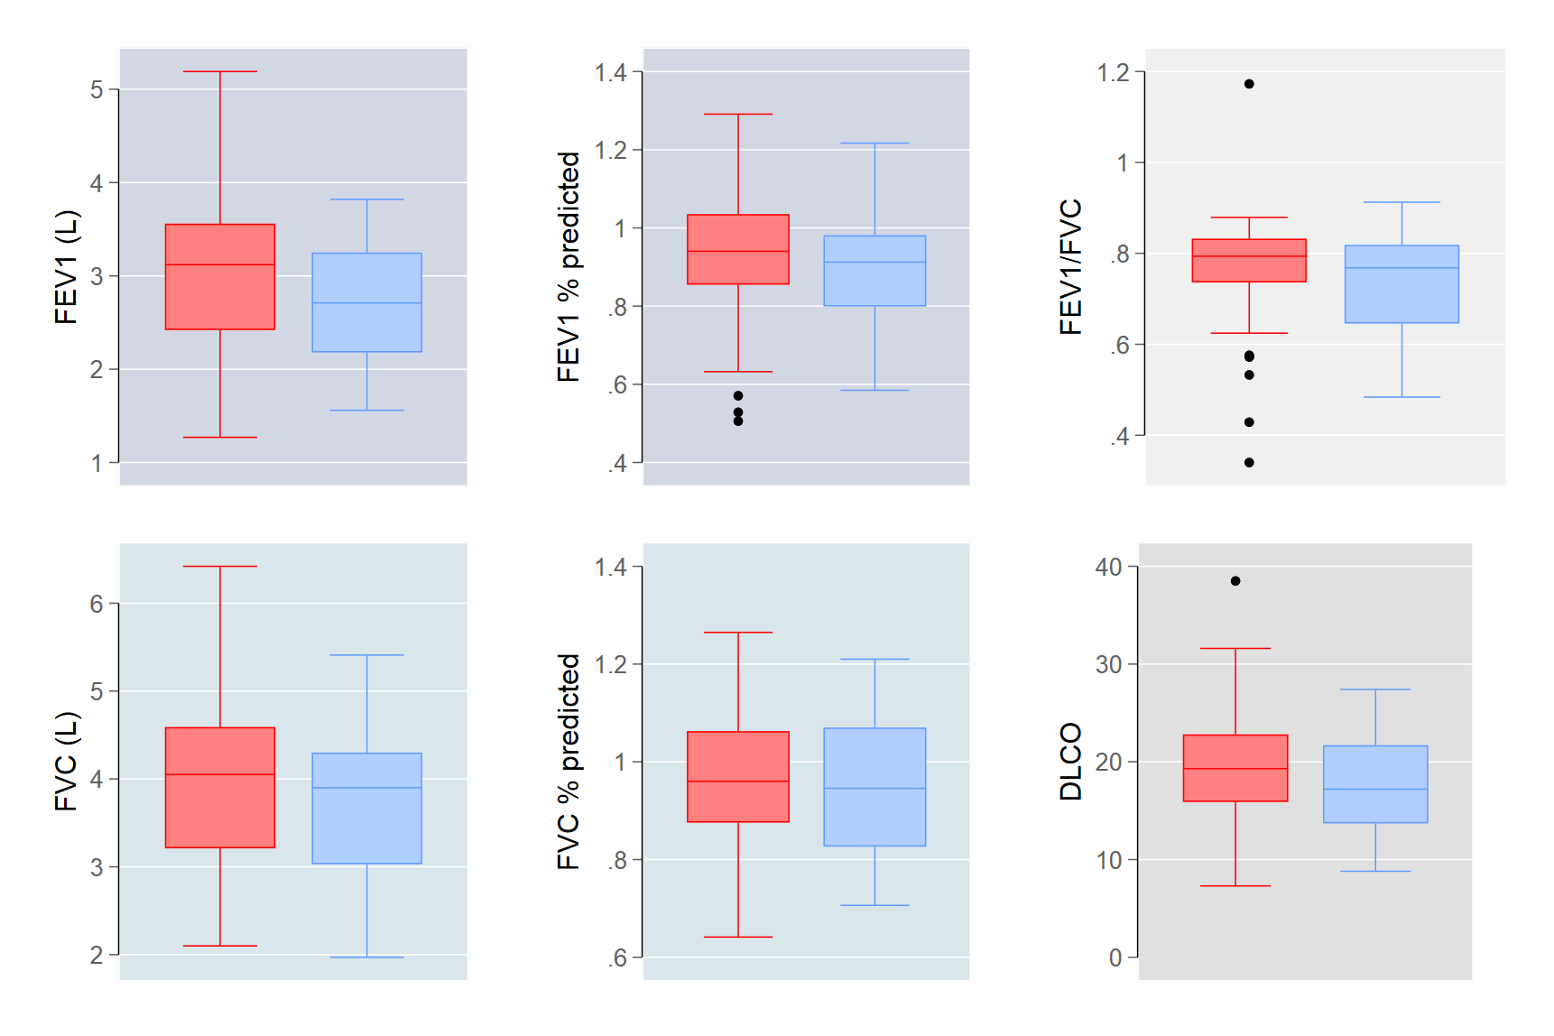
Pulmonary Function Tests
RED – no history of pulmonary OI
BLUE – history of pulmonary OI
3.1
0.94
0.90
0.77
2.7
0.75
p = 0.024
p = 0.174
p = 0.163
0.97
0.96
19.5
17.9
4.0
3.7
p = 0.155
p = 0.679
p = 0.140

Slide 23
Results
Multivariable logistic regression modelling of predictors of respiratory symptoms in PLWH who smoke
 | Total score > 6 | p-value
Age, over 50 | 1.99 (0.79-5.01) | 0.144
Current smoker | 0.39 (0.13-1.12) | 0.079
History of Pulmonary OI | 1.85 (0.57-6.01) | 0.303

Slide 24
Results
Multivariable logistic regression modelling of predictors of respiratory symptoms in PLWH who smoke
 | Total score > 6 | p-value | Symptoms score > 12 | p-value | Activity score > 9 | p-value | Impacts score > 2 | p-value
Age, over 50 | 1.99 (0.79-5.01) | 0.144 | 1.94 (0.74-5.10) | 0.179 | 1.46 (0.65-3.30) | 0.359 | 1.61 (0.74-3.49) | 0.227
Current smoker | 0.39 (0.13-1.12) | 0.079 | 0.28 (0.10-0.79) | 0.016 | 0.50 (0.18-1.37) | 0.181 | 0.67 (0.26-1.75) | 0.412
History of Pulmonary OI | 1.85 (0.57-6.01) | 0.303 | 1.26 (0.41-3.84) | 0.691 | 4.38 (1.22-15.6) | 0.023 | 1.25 (0.50-3.10) | 0.633

Slide 25
Results
Multivariable logistic regression modelling of predictors of respiratory symptoms in PLWH who smoke
 | Total score > 6 | p-value | Symptoms score > 12 | p-value | Activity score > 9 | p-value | Impacts score > 2 | p-value
Age, over 50 | 1.99 (0.79-5.01) | 0.144 | 1.94 (0.74-5.10) | 0.179 | 1.46 (0.65-3.30) | 0.359 | 1.61 (0.74-3.49) | 0.227
Current smoker | 0.39 (0.13-1.12) | 0.079 | 0.28 (0.10-0.79) | 0.016 | 0.50 (0.18-1.37) | 0.181 | 0.67 (0.26-1.75) | 0.412
History of Pulmonary OI | 1.85 (0.57-6.01) | 0.303 | 1.26 (0.41-3.84) | 0.691 | 4.38 (1.22-15.6) | 0.023 | 1.25 (0.50-3.10) | 0.633

Slide 26
Results
Multivariable logistic regression modelling of predictors of long-term pulmonary function in PLWH who smoke
 | Chronic breathing problems | p-value
Age, over 50 | 2.28 (0.95-5.52) | 0.066
Current smoker | 1.31 (0.49-3.52) | 0.586
History of Pulmonary OI | 2.04 (0.86-4.80) | 0.104

Slide 27
Results
Multivariable logistic regression modelling of predictors of long-term pulmonary function in PLWH who smoke
 | Chronic breathing problems | p-value | Require Medical treatments | p-value
Age, over 50 | 2.28 (0.95-5.52) | 0.066 | 2.17 (0.70-6.70) | 0.177
Current smoker | 1.31 (0.49-3.52) | 0.586 | 0.92 (0.26-3.21) | 0.898
History of Pulmonary OI | 2.04 (0.86-4.80) | 0.104 | 2.86 (1.03-7.94) | 0.043

Slide 28
Results
Multivariable logistic regression modelling of predictors of long-term pulmonary function in PLWH who smoke
 | Chronic breathing problems | p-value | Require Medical treatments | p-value | FEV1/FVC < 0.7 predicted | p-value
Age, over 50 | 2.28 (0.95-5.52) | 0.066 | 2.17 (0.70-6.70) | 0.177 | 3.83 (1.16-12.59) | 0.027
Current smoker | 1.31 (0.49-3.52) | 0.586 | 0.92 (0.26-3.21) | 0.898 | 1.65 (0.52-5.18) | 0.393
History of Pulmonary OI | 2.04 (0.86-4.80) | 0.104 | 2.86 (1.03-7.94) | 0.043 | 2.08 (0.76-5.75) | 0.156

Slide 29
Limitations
Although this study had a reasonable overall sample size, there was still a significant difference in size between the groups of patients with and without a history of pulmonary opportunistic infections (37 vs 116).
Subjective reporting of respiratory symptoms and their impact via the St. George’s Respiratory Questionnaire.
Self report of history of pulmonary opportunistic infections.

Slide 30
Conclusions
PLWH with a history of pulmonary opportunistic infections were more likely to be older in age, had lower current CD4+ counts, and lower nadir CD4+ counts.
More likely to have a self-reported history of chronic breathing problems and require medical care for their symptoms.
After controlling for age and current smoking, history of pulmonary opportunistic infection was not significantly associated with chronic breathing problems, total SGRQ score, or FEV1/FVC <70%.

Slide 31
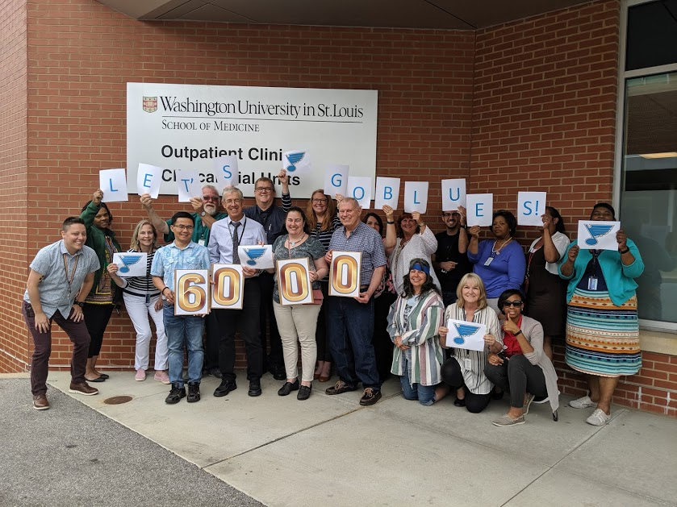
Acknowledgments
Special thanks to the INHALD network and participants!

Slide 32
Acknowledgments
Special thanks to the INHALD network and participants!
Khai Hoan Tram, MD
Resident Physician
Department of Medicine
Washington University in St. Louis
1 Barnes Jewish Hospital Plaza
St. Louis, MO 63110
ktram@wustl.edu

